Slide 1
QVoice feasibility evaluate
Reported by Arthur ,Allen, BJ
Report Date:2017 / 12 / 20

Slide 2
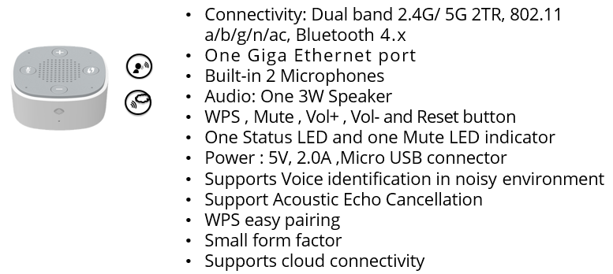
SHS0017W Features

Slide 3
SHS0017W Block Diagram

Slide 4
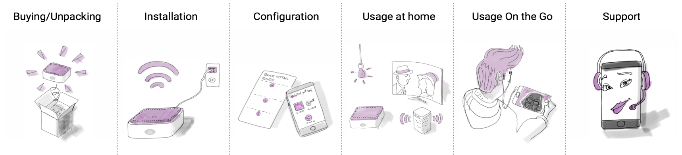
1. Project/Product Components
Fill this Out!
Initial Task for Project Manager + Sponsor:
Decide if needed or not needed in your project
Plan accordingly
No |  | Yes/No
1 | User Experience Design | Y
2 | Hardware | Y
2.1 | Hardware Development | Y
2.2 | ID Design | Y
3 | Software | Y
3.1 | Core Software Development | Y
3.2 | WEB UI | N
3.3 | Mobile App | Y
3.4 | Cloud | Y
3.5 | Tools | Y
4 | Accessories | Y
4.1 | Cables | Y
4.2 | Quick Start Guide | Y
4.3 | Manuals | Y
4.4 | Regulation Papers | Y
5 | Support | Y
5.1 | Support Process | Y
5.2 | Self Care + FAQ | Y
6 | Marketing | Y
6.1 | Packaging | Y
6.2 | Datasheet | Y
6.3 | WEB + PR | Y
7 | Product Management | Y
7.1 | Product Presentation | Y
7.2 | Roadmap | Y
7.3 | Business Plan | Y
8 | Integration Testing | Y
9 | User Experience Testing | Y
User Experience Testing (Friendly User Test with Samples)
9
Integration Testing
8
Packaging Design
Datasheet/Flyer
WEB + PR
Roadmap
Product Presentation
Core Software
Business Plan
WEB UI
Mobile App
Cables
Cloud
Quick Start Guide
Self Care + FAQ
Hardware Dev.
Tools
Support Process
ID Design
Regulation Papers
Manuals
2.1
2.2
3.1
3.2
3.3
3.4
3.5
4.1
4.2
4.3
4.4
5.1
5.2
6.1
6.2
6.3
7.1
7.2
7.3
Hardware
Software
Accessories
Support
Marketing
PM
2
3
4
5
6
7
User Experience Design
What is the end-users Total Experience for every step of the Journey?
User Research (Who are the Users and how do they use it?)
Usabilty (can you achieve the product goal in a simple way?)
Interaction (how pleasant is it to interact with the device?)
Visual Design (The well-considered look and feel of everything)
1

Slide 5
2. Project Charter
Project ID / Name | SHS0017W-D249(RoHS)/ QBee voice
Project Goal | Develop Askey standard Voice Personal Assistant for promoting to our customer.(NOS, SingTel)
High Level Scope | 1. Qvoice can use IoT device(Amazon qualification) skill directly. 2. Q&A
Deliverables | Demo Concept: QBee voice(SHS0017W) connect to QBee box to control IoT device. IoT Device list: Z-wave devices. (Bulb, Plug, Switch); Control way : a. Voice b. App
Milestones | HW:ES build 2nd SMT: 2017/12/09 (50pcs) 10 pcs send to TPE: 2017/12/28 SW: Use Qvoice through the cloud and Qbeehome to control IOT devices, including Z-wave and Bluetooth mesh devices.
Estimated Costs | Safety test(LVD):RMB 6,000 EMC(CE): RMB 112,000 Environmental Impact Assessment: USD 1,900 Tooling fee: USD$55,000 Mock up fee: NTD $88,200 Human resource: NTD$ 25,004,000 Production factory line: NTD 196,300 Sample cost: USD$24.42 * 220 = USD$ 5372.4 Total:NTD $27,759,049
(Potential) Customer(s) | NOS, SingTel
Vendors / Partners | HW: Realtek: RTL8197, RTL8822, ALC5680 | SW: SW team: Arichi team. Cloud: Cloud (Archer) APP team (Kings)
Review and Approval (Key Stakeholders) | Project Manager: B.J. Lee Product Manager: _Allen Chung_________ Project Sponsors: ___Robert Lin______________________

Slide 6
3. Project Organization
Sponsor+
Steering Committee
Robert,Eric,Alan,Auger,Arthur,Frank
Project Manage
PJM/B.J. Lee
Product Manger
PLM/Arthur
UX/UI
Amiga
HWRD Yuzhao
MERD Daniel
Software Manager
SWPM/Taimin
Operation
FPM/Andre
Support
Marketing
Cecile Hanel
PLM
Allen Chung
HWRD Wei
cheng
ID
Adam Lin
SW APP
Jason1 Su
SW Driver
Ryan Hsu
SW APP
Leo2 Cheng
SW Cloud
Thomas Wong
Product line Control
Jian Xu
SQC
Amy Xu
RDTE
Lester Lin
DQA
Quanhua
MPM
Sheila Wu
PCB Layout Abel Zou
Thermal
Kevin Huang
SW Driver
Wilson Hung
SW APP
Cooper1 Chen
SW Cloud
David5 Huang
Material
Control
Davy Lee
PQC
Weiping Yu
HW SIT
Juan Chu
QTR
Vickiya shen
PKG
Design Erin Yang
SW Driver
Jada Lin
SW APP
Indy Hsiao
IE
Ming Liu
OQC
Ameer Zuo
SW SIT
Peter2 Chang
EMC
Lino Zhu
Label
Design Wei Hou
Produc TE
Boyce Dong
CQC
Yee Yi
SW SIT
Randy Hsu
Safety
Chen Lin
SW SIT
Peichun Wu

Slide 7



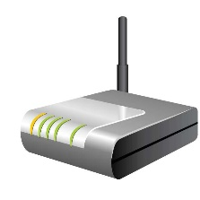

CES Show:
QBee Home + Qvoice
AWS IoT
MQTT Mobile APP
AVS
Message handler
UI handler
Mobile App
Message contents in MQTT packets are Askey proprietaries.
Home gateway
QBee Home
AVS message flow
Applications
MQTT message flow
MQTT Agent APP
MQTT
Local server
Message handler
BT Mesh handler
Zwave handler
QVoice
BT MESH control APP
(Askey)
Z-wave control APP
(Askey)
Alexa client
Software
Framework, Library, and Kernel
Linux kernel
Software
Hardware
Bluetooth module
Zwave module
MIC, SPK and codec
Hardware

Slide 8
4. Project Milestones Overview
Project ID/Name | SHS0017W-D249 / QVoice | Date: | 20 Dec. 2017 | Overall Status
Milestone 1
15th Dec. 2017
Milestone 2
26th Jan. 2017
Milestone 3: Launch
2nd May 2018
Components |  | Sep | Oct | Nov | Dec | Jan | Feb | Mar | Apr | May | Jun |  | Jul
1. UX Design
2. H/W | 2.1 Hardware dev.
 | 2.2 ID Design
3. S/W (before CES) | 3.1 Device SW
 | 3.2 Cloud 3.3 SW SIT
S/W (Standalone) | 3.4 Device SW
User Experience Design
5/2
12/26
QA
ES
QA
EV
DV
QA
PV
QA
Mock up x14pcs
Mock up-16pcs
Hard tooling start TBD
1. bring up 8197+5680 EV 2. ALC5680可收wake word
1. AVS control 2. fix WPS and Reset 3. incl. bootcode & root file system
LWA & AVS Skill modification
Integrate with Z-wave & BT
RD SIT for Qvoice only
RD function test and formal release test
RD function test and formal release test
Auto Refresh token, WPS, Telnet
Dual image, IPV6
Support production line and test FW

Slide 9
4. Project Milestones Overview
Project ID/Name | SHS0017W-D249 / QVoice | Date: | 04 Dec. 2017 | Overall Status
Milestone 1
15th Dec. 2017
Milestone 2
26th Jan. 2017
Milestone 3: Launch
2nd May. 2018
Components |  | Sep | Oct | Nov | Dec | Jan | Feb | Mar | Apr | May | Jun |  | Jul
4. Accessories | 4.1 Cables/adaptor
 | 4.2 Quick Start Guide
 | 4.3 Manuals
 | 4.4 Regulation Papers
5. Support | 5.1 Support Process
 | 5.2 Self Care + FAQ
6. Marketing | 6.1 Packing Design
 | 6.2 Data Sheet
 | 6.3 WEB + PR
7. PM | 7.1 Product Presentation
 | 7.2 Roadmap
8. Integration Test
9. UX Testing
Develop
QA
Procurement
TBD
QA
TBD
TBD
QA
Infrastructure
TBD
Proposal
QA
TBD
QA
TBD
QA
CES
Launch
Infrastructure
Testing Script
Unit Test
Integration Test
QA
Friendly User Test (6 samples ready for Qbee box integration testing)- pending
QA

Slide 10
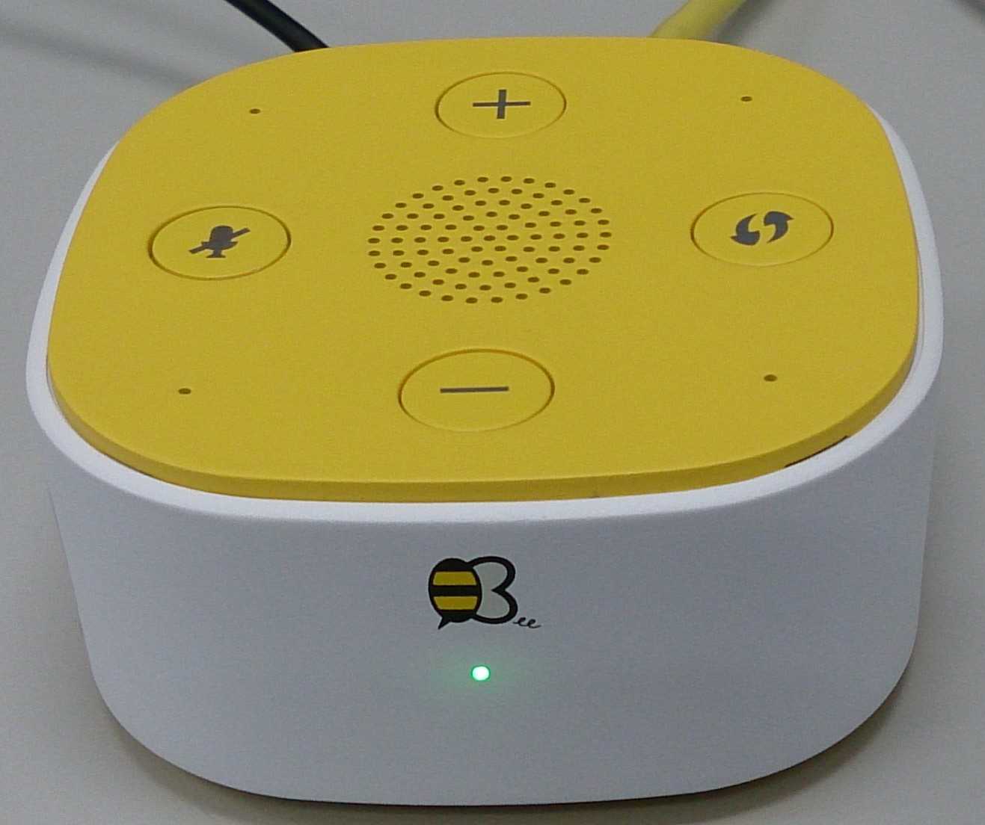
SHS0017W Software Features
Voice assistance
Basic AVS Q&A
Sing a song
Alarm/Timer
Streaming (play ICRT, podcast, news….)
Volume up / Volume down / mute / un-mute
Support Amazon skills (translation, …….)
Support IoT devices control (e.g. Lutron turn on/off light, TV controller on/off…..)
Network
Ethernet 10/100/1000M bps
Web download
Telnet function
WIFI
WI-FI 2.4g/5g AP/station mode (802.11b/g/n)
WPS server/client mode function
IPv4, IPv6
Dual image
In the future:
Network security/firewall (防火牆預防網路攻擊)
Support UPnP
Bluetooth functions
Connect to speaker / home sound system

Slide 11
QVoice SW Check Points For CES Show
11/6~11/10
* Login with amazon and mapping to Askey User Account (Cloud Team Only)
* AVS Skill for CES scenarios (I) single device
11/13~11/17
* AVS Skill for CES scenarios (II) multiple devices ( living room light + kitchen light )
* AVS Skill for CES scenarios (III) all devices (leave or back)
11/20~11/30
Integration test with z-wave devices and BT devices.
11/25~12/15
RD debug for Integration test
12/15
Cloud sw fixed version
10/24 release test image
1. 5680可收wake word
2. 8197 Alexa client can control device and general reactions
10/23 ~11/3 AVS Status control
(Led shine: connecting to AVS,
Led off: connected to AVS success )
11/3 ~11/17
check and fix WPS & reset to default button .
11/20 ~ 11/30
include bootcode and root file system in a burn file (only include bootcode currently).
12/01~12/15
RD debug for integration test
12/15
Qvoice device sw fixed version
RD development stage
SIT integration test stage
CES show (2018/1/9~12)
10/23:
RD SIT test V335 (1023v)
11/1~11/3:
RD SIT test V335 (1101v)
11/16
RD SIT test V335 (1115v)
11/22 RD test 1122v @ Askey PCBA
11/27 RD test 1127v @ Askey PCBA
12/04~12/08
integration test
12/11~12/15
integration test
11/10 ES sample (16 pcs for SW)
2017
2018
October
November
December
January

Slide 12
Standalone Functions Development
Archi team
Mobile app
Cloud team
Jada team
12/01~12/15: dual image:
1. Partition
2. Generate firmware image for burning
3. Firmware upgrade
12/18~12/31:
Support production line and test software development
Fix bug and fine tune firmware.
11/26~11/27:
Web download for single
11/20~11/30:
Auto refresh token
11/24
11/27
11/30
12/13
12/15
12/31
11/22~11/24:
Telnet function
12/04~12/13
IPv6 module in Kernel
12/18~12/31
Support production line and test software development
Fix bug and fine tune firmware.
11/13~11/24:
WPS function

Slide 13
5. Project Risks
Project ID/Name |  | QVoice |  |  |  |  |  | Reporting Week | CWNN
Risk Nr. | Date Identified | Category | Description | Probability Level | Impact Level | P*I | Response | Contingency Plan | Risk Owner | Status
001 | 2017/11/28 | HW | WiFi will be drop line after write RF calibrated data into Qvoice | 3 | 4 | 12 | PJM/BJ | HW tried to tune RF matching as FAE suggestion. Realtek agree us deliver one board to debug in Realtek’s RD. | Yuzhao | ES
002 | 2017/12/04 | HW | Observe No3 sample poor voice recognize with Flypower’s PSU. | 3 | 4 | 12 | PJM/BJ | 1. First step validated Flypower PSU (it will drop to 4.45V). 2. Phihong PSU will deliver to WJ HWRD on Dec.25 | Yuzhao | ES
003 | 2017/12/20 | FW | Build code version control | 4 | 3 | 12 | PJM/BJ | 1. It needs to align with different SW team. 2. Use bitbucket to sync and control software. | SWPM / Taimin | ES

Slide 14
5.1 Solved Important Issues
Project ID/Name |  | QVoice
Issues Nr. | Date Identified | Category | Title | Status | Description
001 | 2017/12/01 | FW | Cannot sign a song | Solved | The function support in current firmware (1215 toggle)
002 | 2017/12/01 | FW | Timer/Alarm cannot give an indication | Solved | The function support in current firmware (1215 toggle)
003 | 2017/12/01 | FW | 連續做2次串流播放, 第2次的串流無法播放. | Solved | The function support in current firmware (1215 toggle)
005 | 2017/11/30 | FW | Include bootcode and root file system in a burn file | Solved | Realtek release patch, askey RD test OK.
006 | 2017/12/04 | FW | AVS always wait (LED 恆亮問題) | Verifying | 之前網路狀況不好，此問題時常存在 經過AVS client優化，此機率已降為 6/800 = 0.75%
007 | 2017/11/22 | FW | 語音指令Volume UP / Volume Down / Mute / Unmute 有機會失敗 | Verifying | 經過AVS client優化，成功機率： Alexa, Volume Up: 90% (9/10) ➔ 100 % (100/100) Alexa, Volume Down: 90% (9/10) ➔ 100 % (100/100) Alexa, Mute: 100% (10/10) ➔ 99 % (99/100) Alexa, Un-mute: 80% (8/10) ➔ 100 % (100/100) 總失敗機率從10%降為 1/400= 0.25%

Slide 15
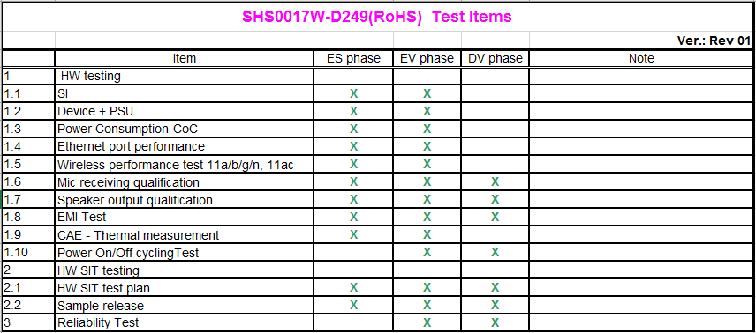
5.2 HW test plan
12/21: FW release – fix 2.4GHz EVM issue
12/22: HW pretest
12/26: HW/SW freeze version for ES HW testing.
1/28: First round HW items test in ES phase.

Slide 16
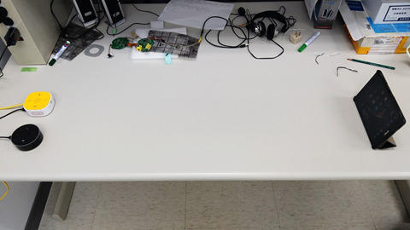
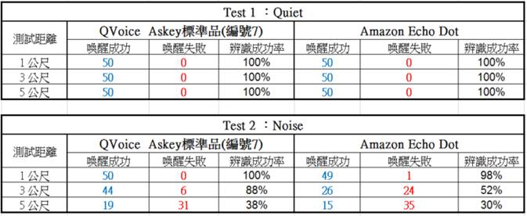
距離辨識效能測試
[Askey QVoice(7號)距離辨識效能測試]
測試機台 ：QVoice Askey標準品(7號) v.s. Amazon Echo Dot (測試對照組)
FW version：bootloader：shs0017w_boot_dual_static_20171201.bin
kernel：shs0017w_fw_dual_RTK_patch_20171204.bin
HW version：Askey QVoice 標準品(編號7)
量測方式 1(Quiet)：以平板電腦發出固定的Wake Word指令：Alexa, 在直線1公尺、3公尺、5公尺等距離,做測試機台辨識成功率統計
量測方式 2(Noise)：以平板電腦發出固定的Wake Word指令：Alexa, 並且在斜角45度 2公尺處放置Noise Speaker(電腦以固定音量播放音樂),
在直線1公尺、3公尺、5公尺等距離,做測試機台辨識成功率統計.
(環境音量約40分貝、平板電腦發出Wake Word音量約60分貝、Noise Speaker發出的音樂音量約50~70分貝)
[測試結果]:
由下表測試結果, Askey QVoice(編號7)在有噪音下的”Alexa Wake Word喚醒”測試結果, 略優於 Amazon Echo Dot.
[驗證結果如下]:

Slide 17
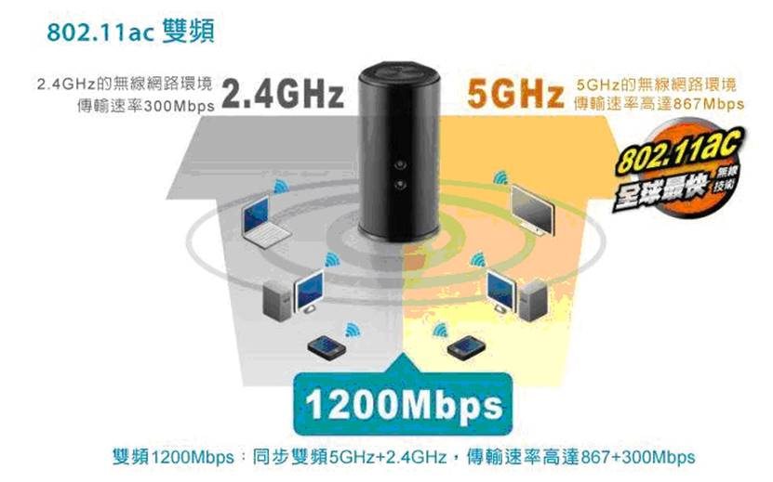
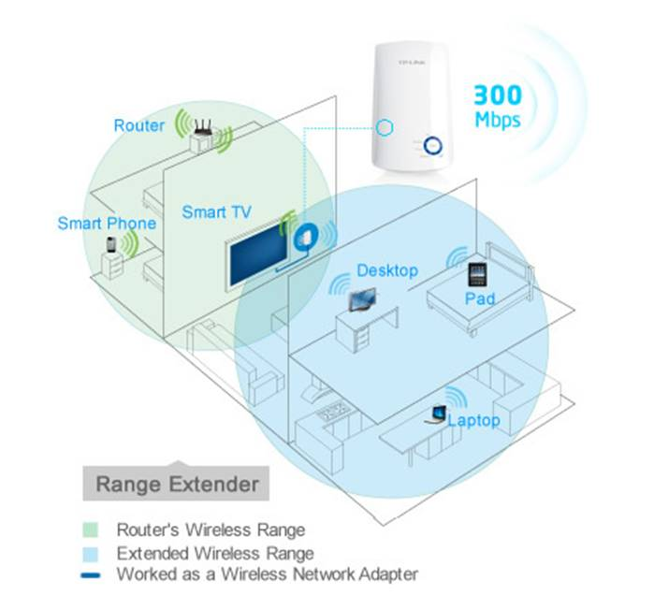
QVoice 應用場景 – IP分享器 + 語音助理
Pocket size (家用旅行都方便)
支援路由器, 基地台(AP), 中繼器 (repeater)
最新 802.11ac 無線技術 (相容於 802.11 a/b/g/n), 2.4G/5G 雙頻同步
支援雲端服務可遠端管理
智慧防盜 (出門在外時可遠端遙控開關燈、放音樂, 營造有人在家的氛圍)
智慧教育 (即時英語對話, 訓練聽說能力)

Slide 18
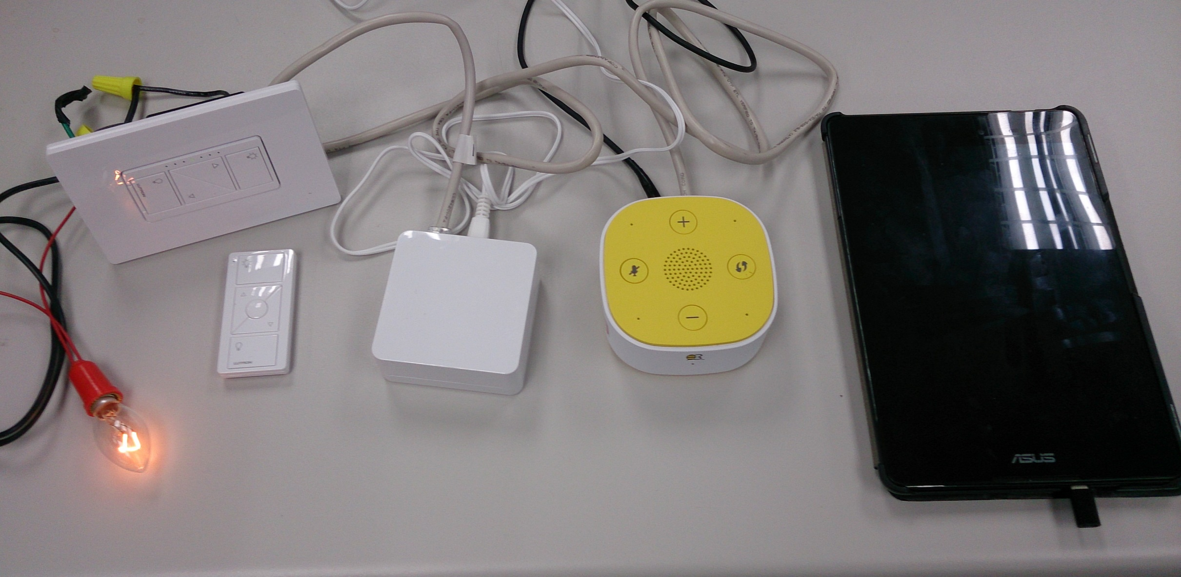
Qvoice Control Lutron IoT Device Demo
Lutron IoT
LTE router
Lutron IoT GW
QVoice
Lamb
Scenario:
Basic Q & A
IoT control
Alexa, turn on the (office) light.
Alexa, dim the office light.
Alexa, set the office light to 20 percent.
Alexa, turn off the (office) light.

Slide 19
QVoice軟體人力規劃
QVoice SW
17
11
3
3
QVoice
Device SW
Cloud
SW SIT
于岱民
蕭有廷
鄭協龍
陳楷富
吳家豪
紀彥丞
姜依帆
黃郁茹
林毓達
洪俊原
許裕昇
黃智敏
黃士帆
陳品宏
張堯翔
吳佩君
許哲維

Slide 20
System Architecture (Voice Assistant)
Alexa C Client
Askey porting
Speechrecognizer Processing
Speechsynthesisizer processing
Wake word engine
MQTT Client/Server
Response Message
Context processing
Askey Customized
Get refreshtoken
(registration)
Request Message
Audio player processing
RealTek alexa client
HTTP/2
Open source library
Web server for setup
Alerts processing
Alexa Settings
Linux
Wake word engine
Authentication
Hardware
Device Config.
Sensory lib
WakeWordDetected()
Wake Word Handle
ALSA config for microphone & speaker
Askey library
ALSA Library
HTTP Client Library
libcurl
OpenSSL
Linux Distribution
RTL 8197 + RTL 8822 + ALC5680

Slide 21
Cloud Architecture for Alexa
Project Customized
service
HAP Biz Console
OAuth Aggregate
Skill Lambada/
CES excel
FOTA Service
Askey Cloud Component Service
Biz Console API
Identity Service Connect (LWA)
Smart Things Service
Version Update Service
Device Enrollment
IoT Rule
AWS Service
Device Registry
Data ETL
MQTT Server
Web Server
Data Pipeline
IoT Rule Engine
NO SQL
Columnar Storage
Object Storage
Cross AZ backup
System Auditing
CDN Service
DNS Service

Slide 22


